Slide 1
KL (Kanade-Lucas) Tracker using Mono and Stereo Footage
Sean Oldenburger

Slide 2
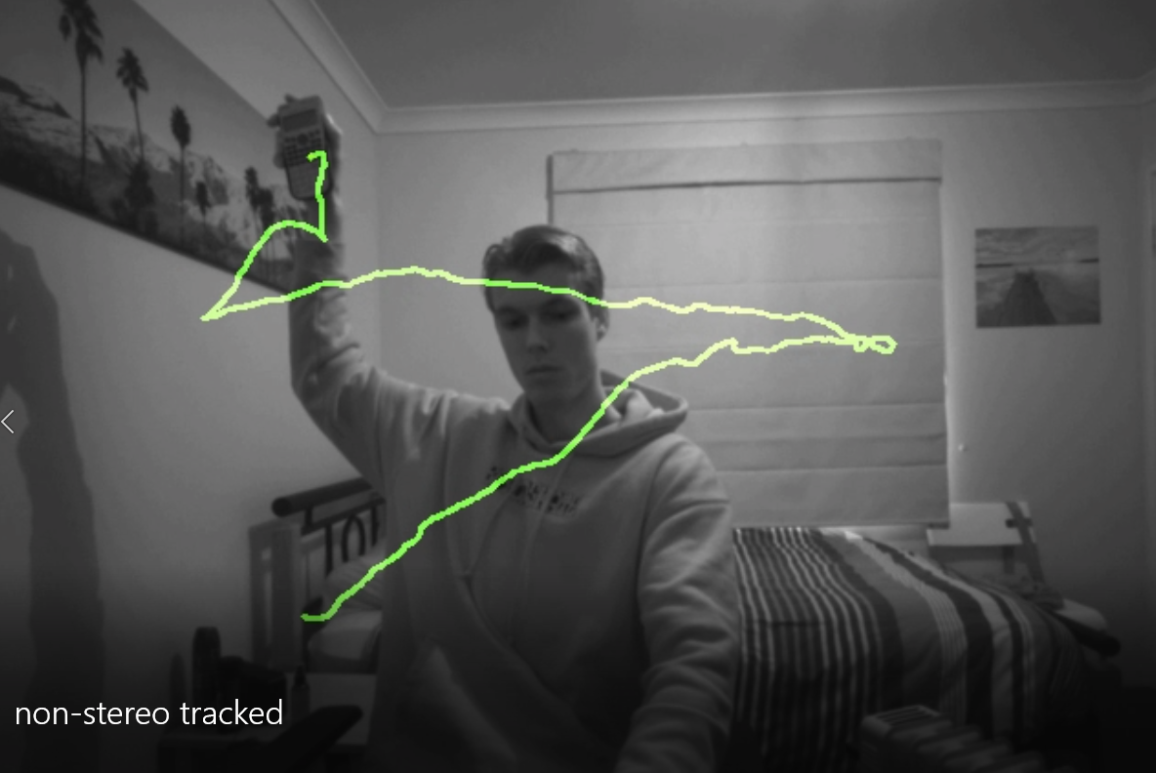
Non-Stereo footage tracking
Input video name: “Non-stereo footage.mp4”
Output video name: “non-stereo tracked.mp4”

Slide 3
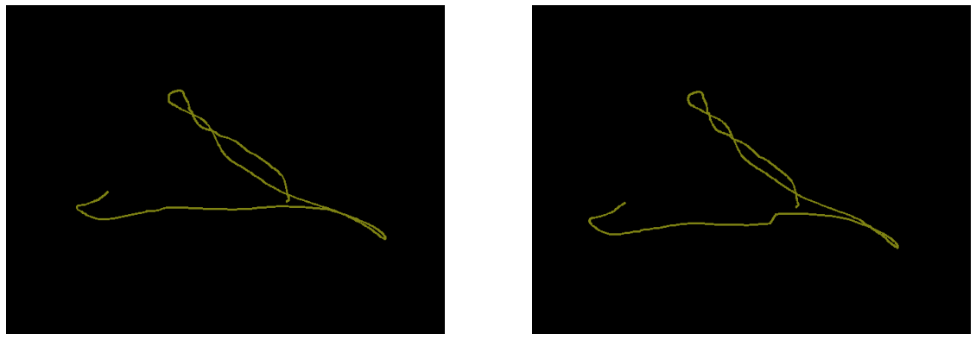
Stereo footage tracking
Video name(s): “stereo footage left/right.mp4”
Output name: “stereo footage tracked.mp4” (has depth colour in tracking path)
Left and right video tracking output (can see the slight changes from their 2 different perspectives)

Slide 4
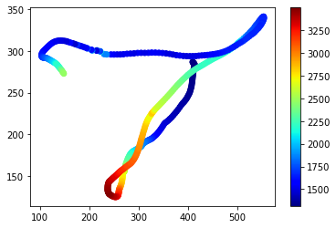
Same tracking but now with depth information found (depth scale in cm)
Can follow with the video to see that this mapping is indeed correct in relation to the x, y and z(depth) directions

Slide 5
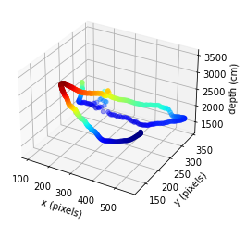
3D graph of the stereo tracking:

